Slide 1
Waterkinesis Day 2
Assembly and Exploration

Slide 2
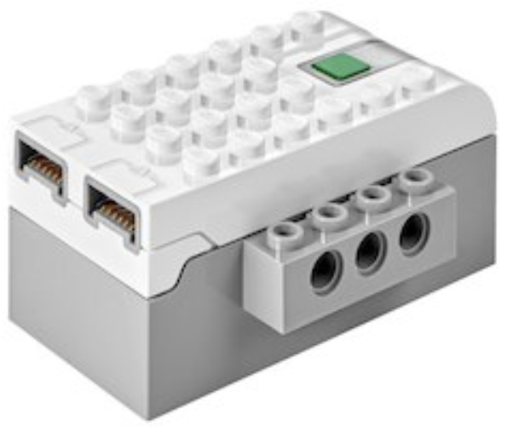
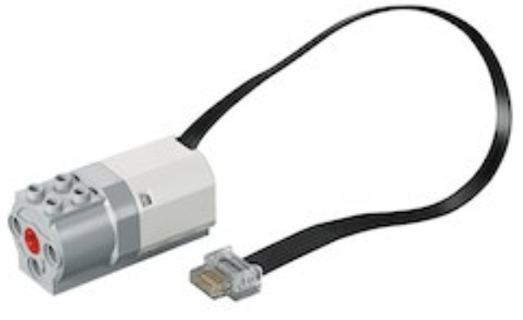
Assembly
Important notes:
1 motor and 1 smarthub per group
Connect the motor to the back of the smarthub
Block one of the holes in the waterproof box using velcro tape
Connect the Wedo to your laptop before securing the box lid
Be creative! Try a couple of designs and see which one works best for you

Slide 3
Exploration
Explore the possibilities! You can:
Create a game with your project
Combine your project with another team
Create a competitive game with other teams
Add effect with other Cognimates extensions
Do something new!

Slide 4
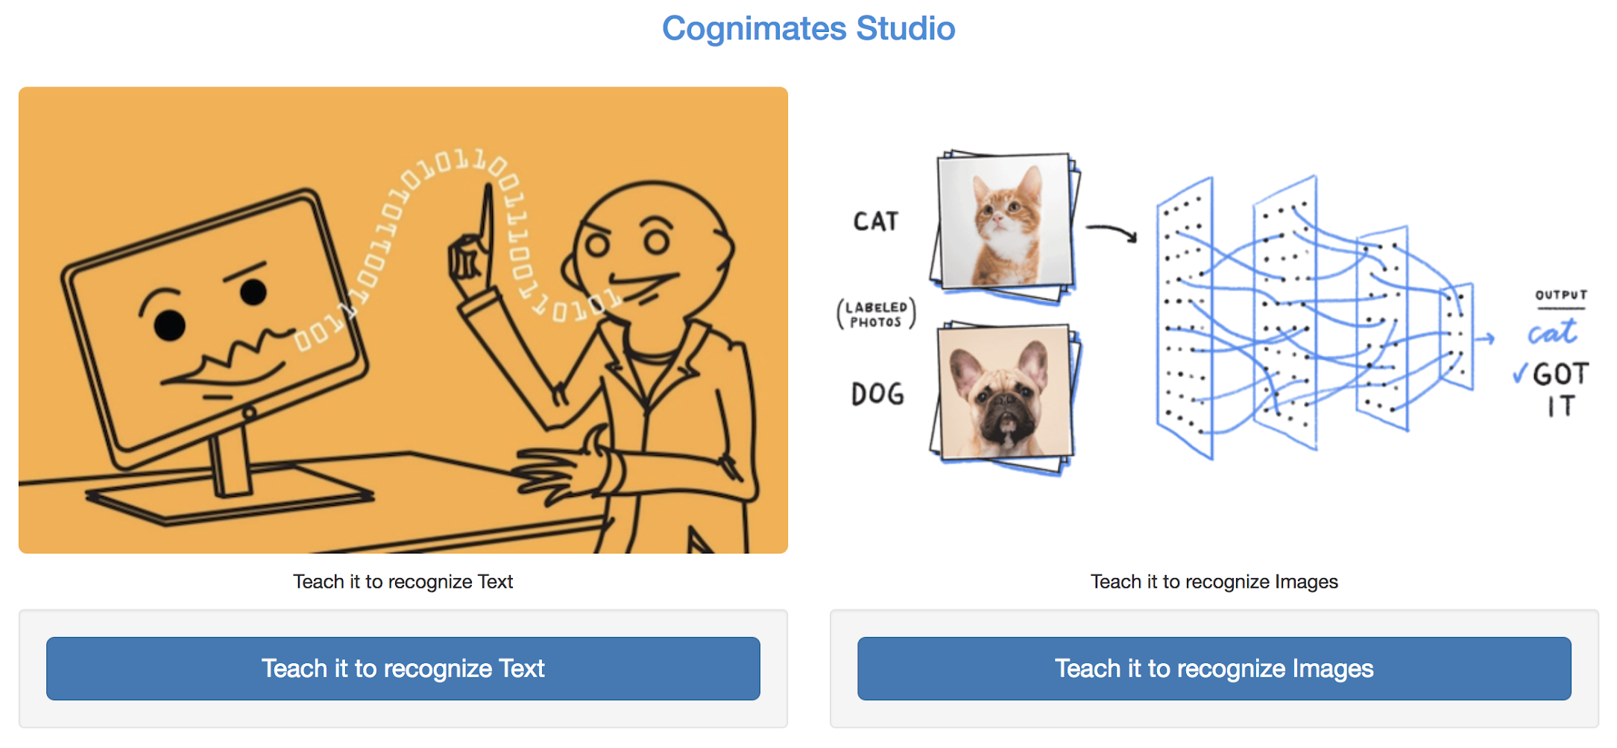
Discussion
Do you think we should continue to train models that recognize things? Why or why not?

Slide 5
Let’s demo!
Share or demo the game your group created with the Muse and Wedo sets!

Slide 6


Reflection
What did you learn?
What did you like?
What could have gone better?

Slide 7
Thank you!
We hope you enjoyed the project!

